Slide 1
Forces Sandbox Presentation #3
By James Hribal, James Crocker, Alex Athimaritis

Slide 2
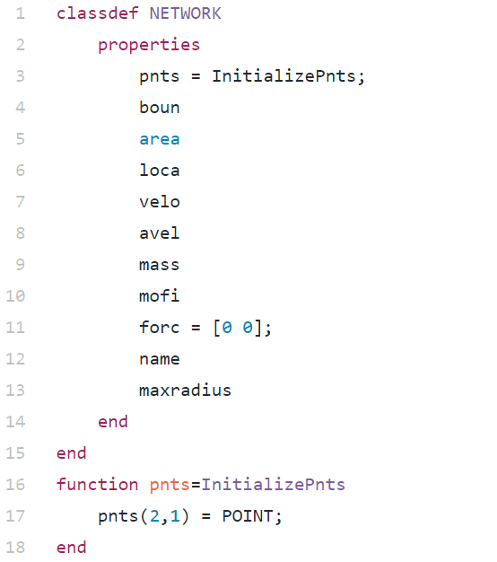
Network (Object)
Object called NETWORK has properties
Pnts
Boun
Area
Loca
Velo
Avel
Mass
Mofi
Force
Name

Slide 3
Collision Detection

Slide 4
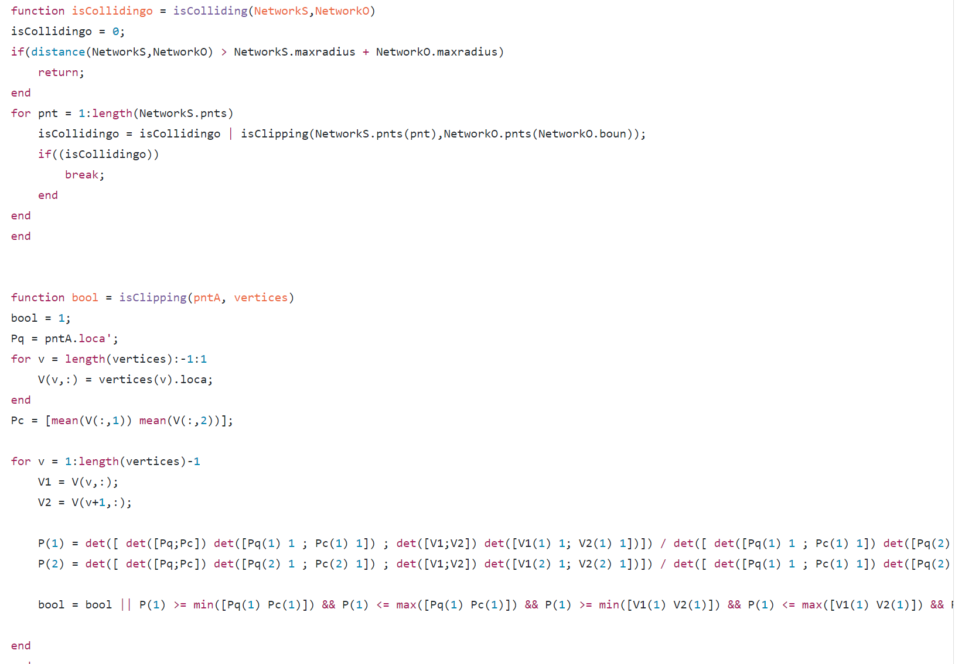
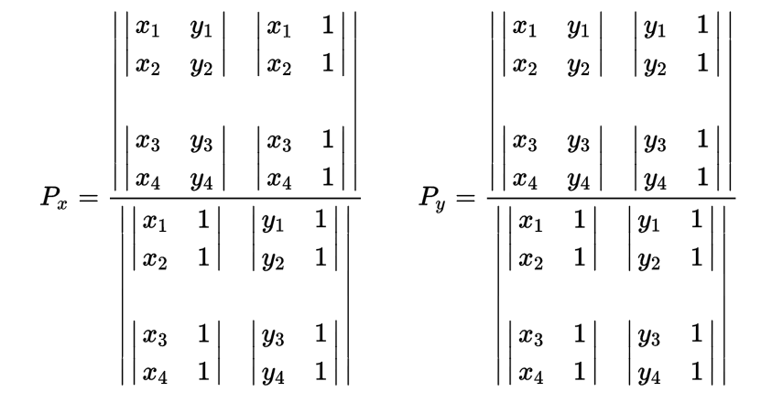

Slide 5
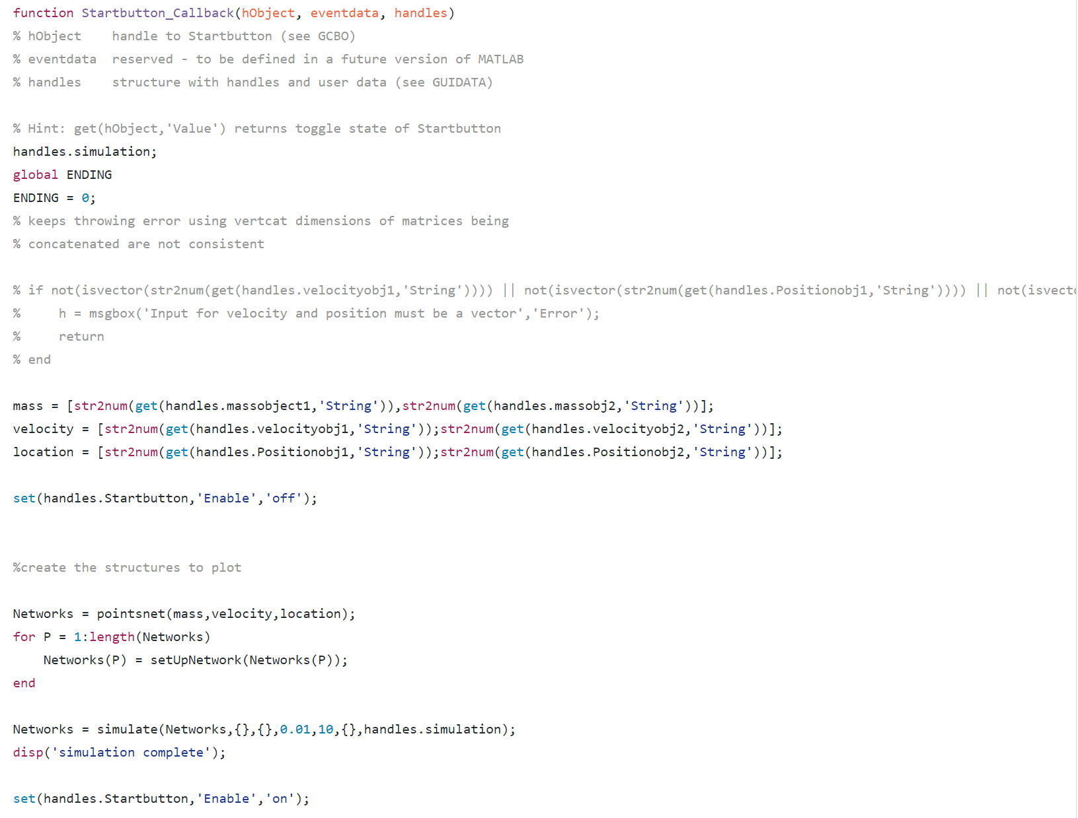
GUI Code
Calls the axis (handles.simulation)
And creates global variable ending which is used for the pause button
Variables assigned to input from user
Disables the start button after the user presses it once until simulation complete
Takes the information from the user and passes it to the simulate loop

Slide 6
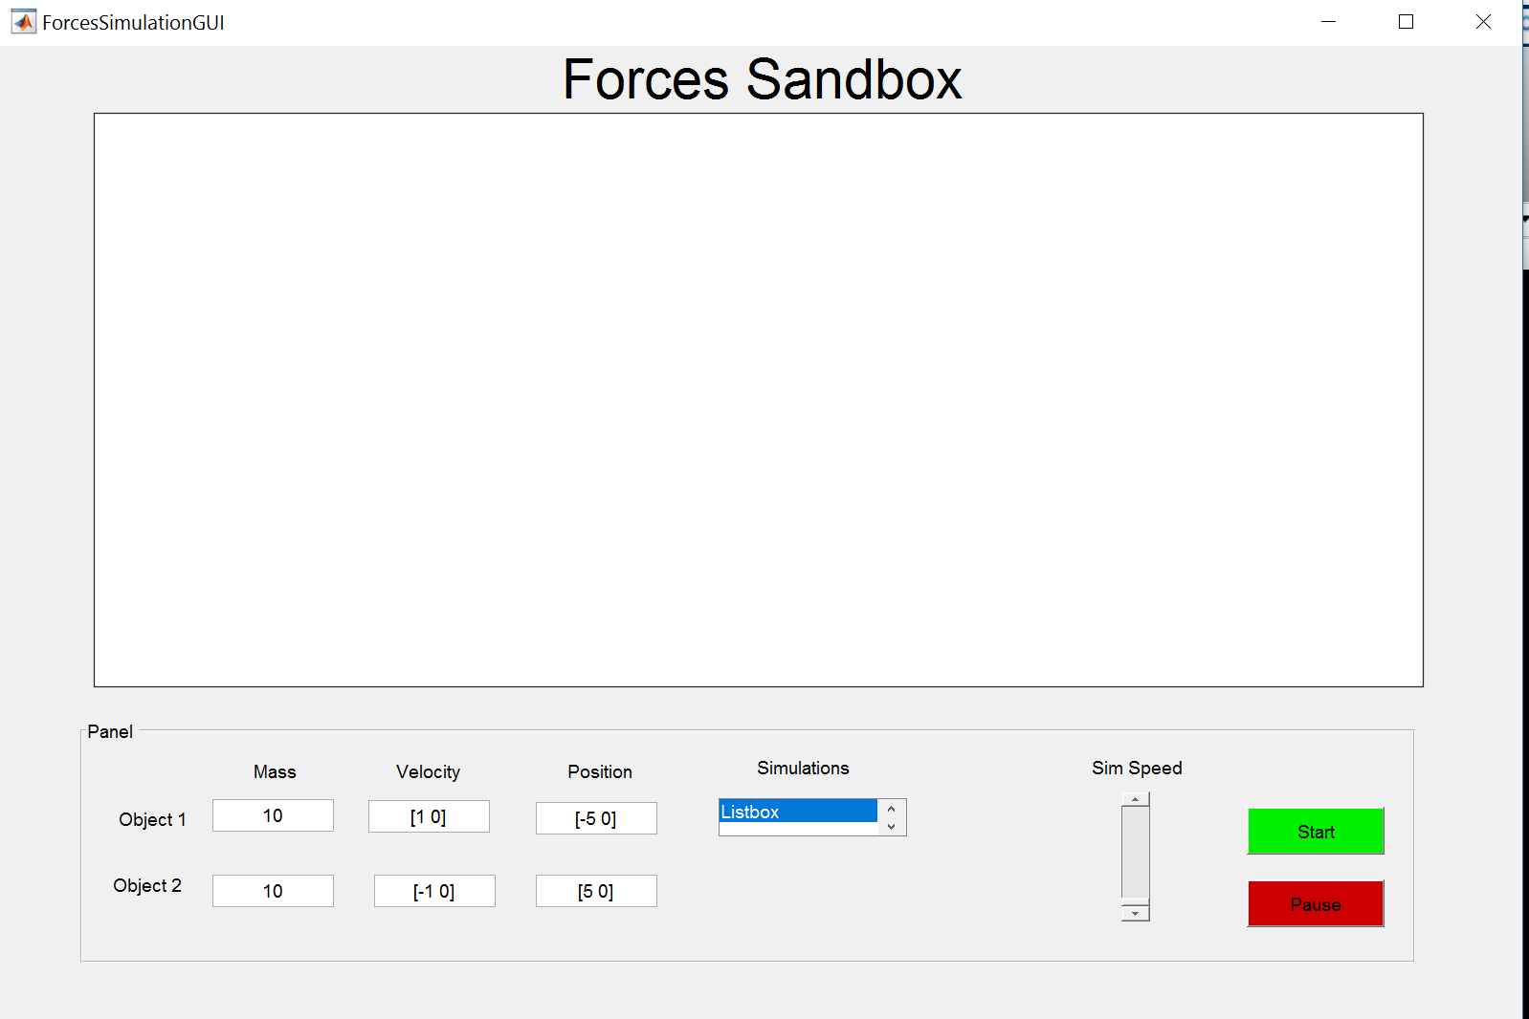
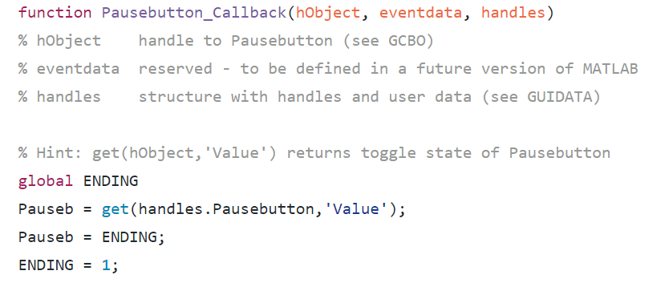
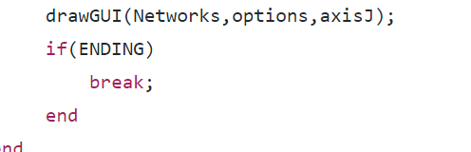
Axis will display the polygons once the user inputs the information
Velocity and position must be entered as vectors

Slide 7
Goals
Reimplement forces
Allow for more than 2 networks to be used in the GUI
Create preset simulations that can be run by the user using the simulation listbox

Slide 8
Demo

